Slide 1
14.01.2025
Pascal

Slide 2
Test snowstorm impact

Slide 3
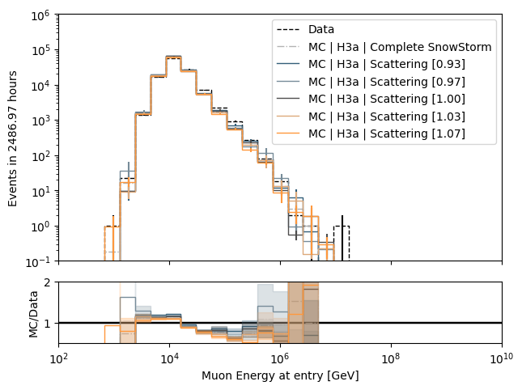
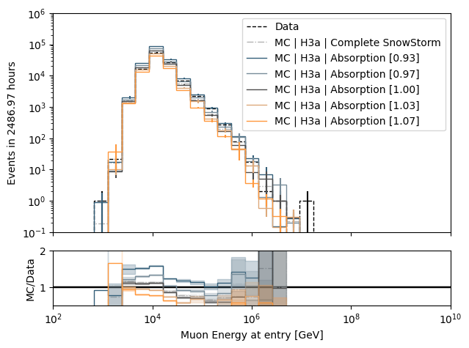
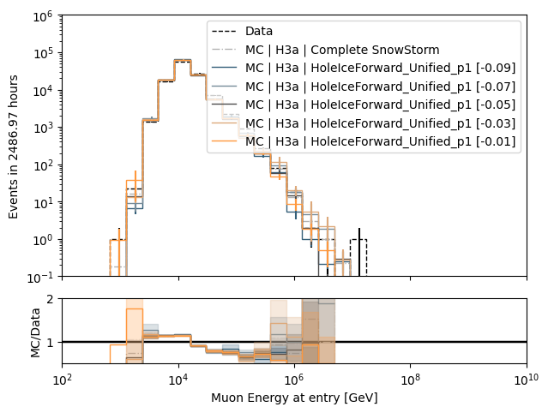
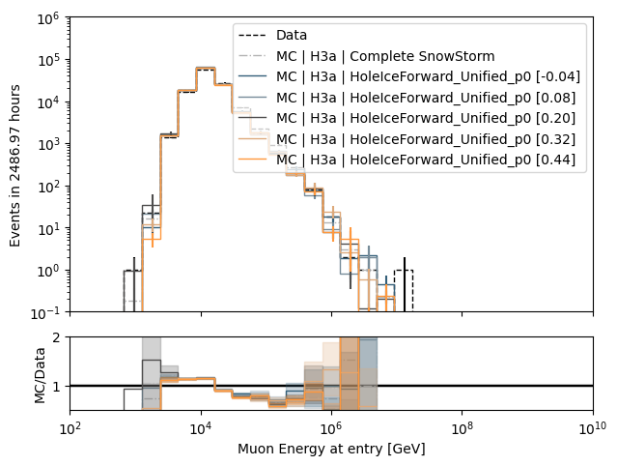
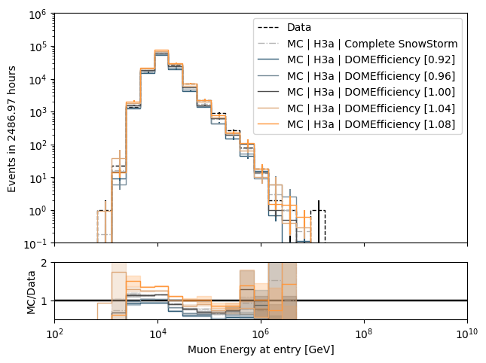
Muon energy at entry - proxy

Slide 4
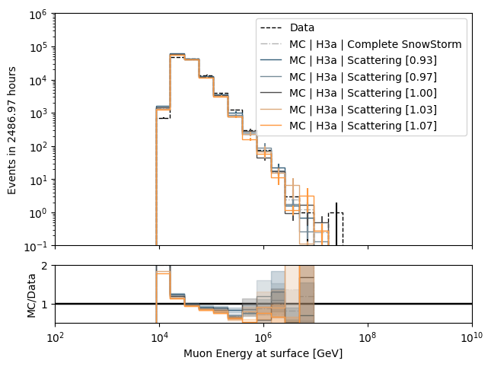
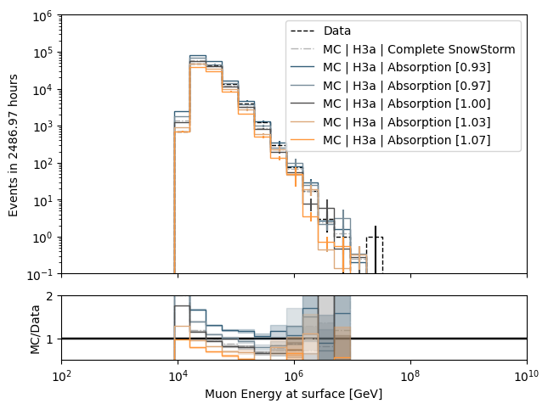
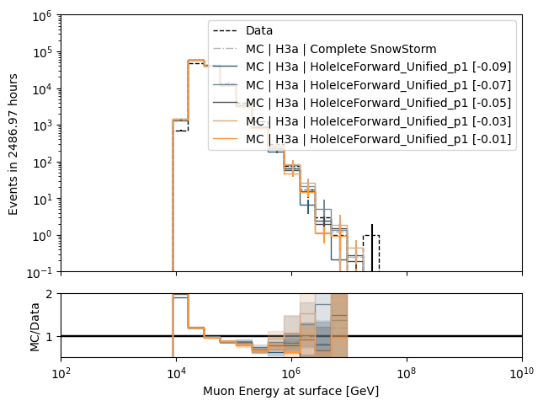
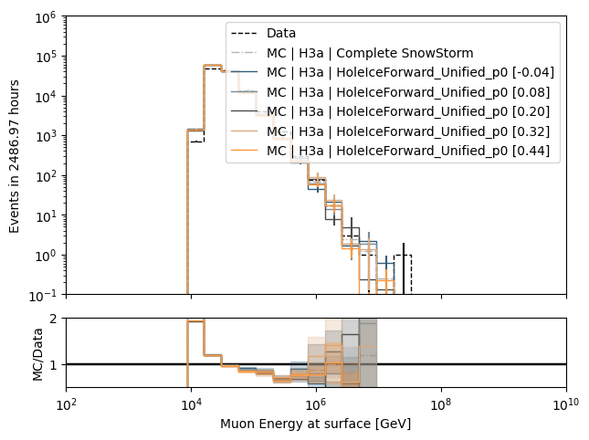
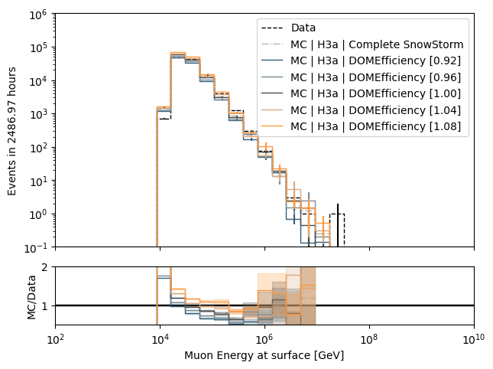
Muon energy at surface - target

Slide 5
use chi2 test with lower and upper 20% interval to check significance

Slide 6
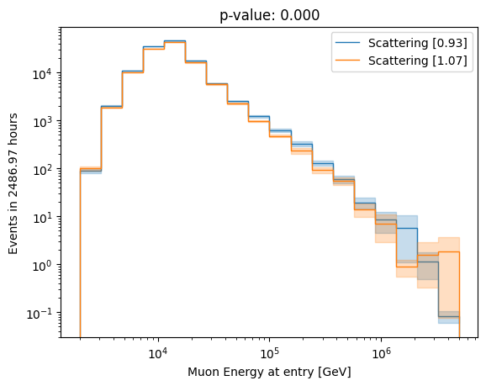
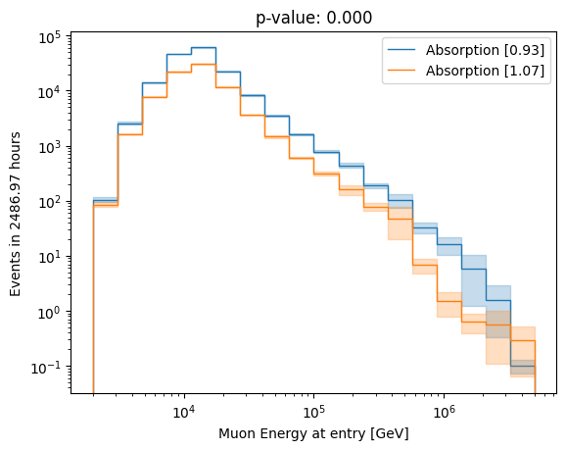
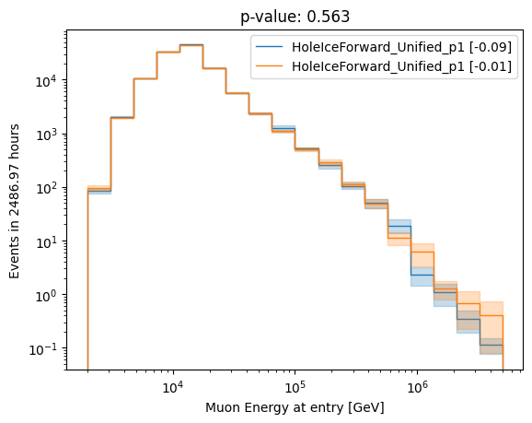
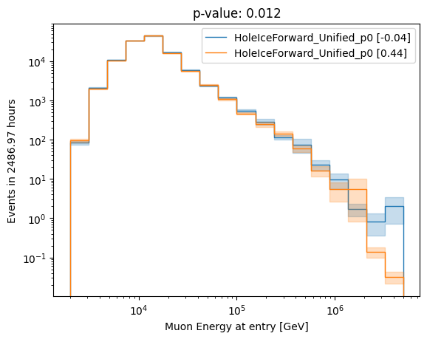
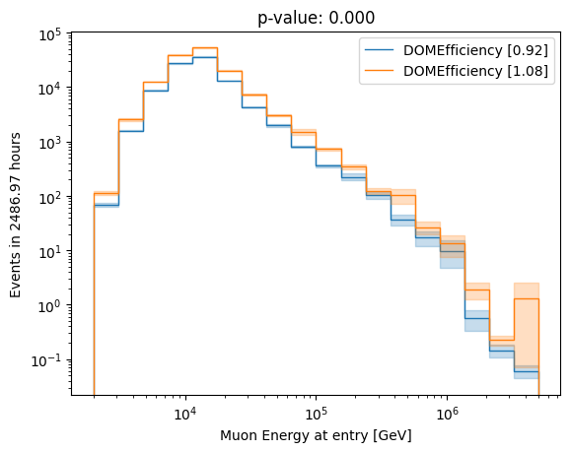
Muon energy at entry - proxy

Slide 7
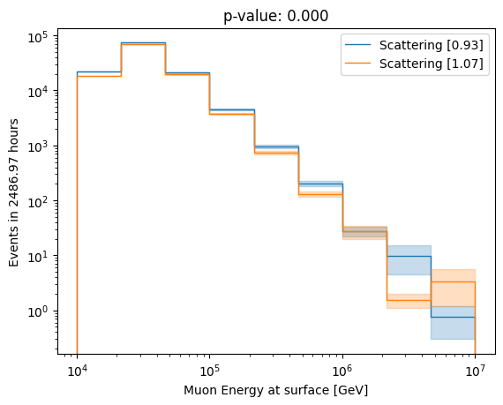
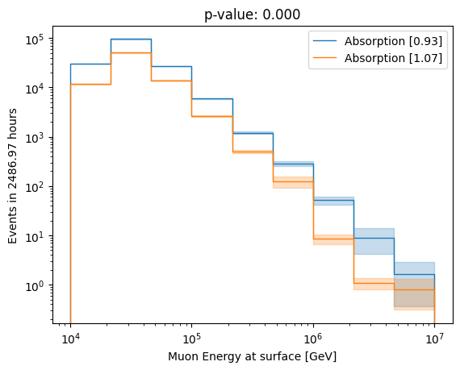
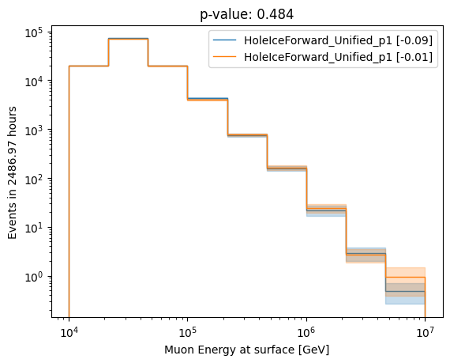
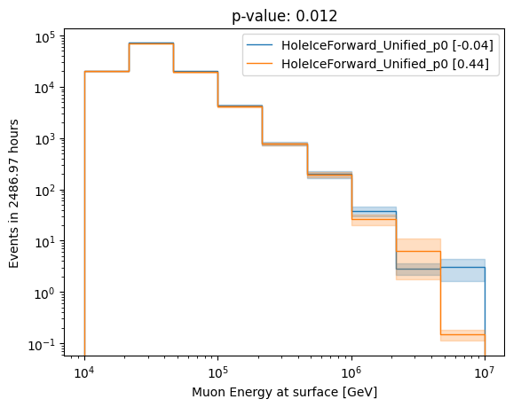
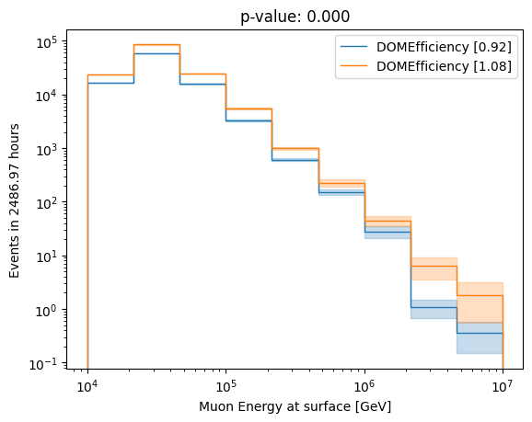
Muon energy at surface - target
neglect HoleIce p1 systematic

Slide 8
unfold event rate

Slide 9
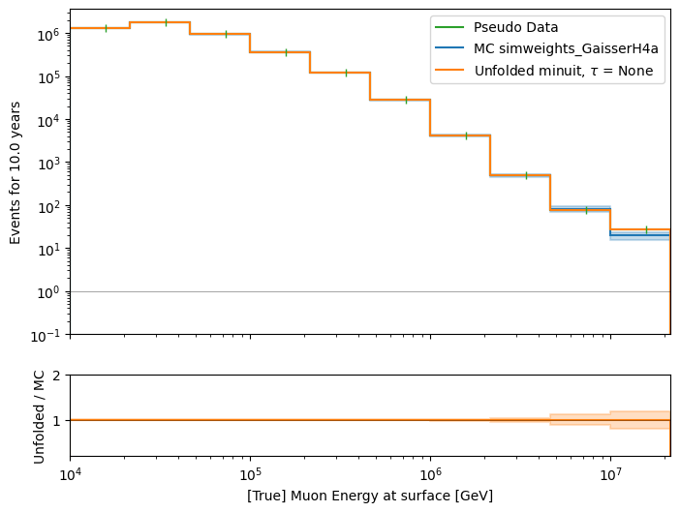
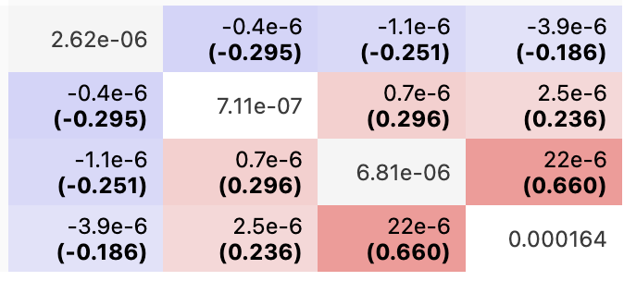
fix all bins, fit 4 systematics
x0 = [True values , 1, 1, 1, 0.2], bounds = yes
Scattering: 1.0165
Absorption: 1.0069
DOMEfficiency: 1.0302
HoleIce p0: 0.193
hesse matrix

Slide 10
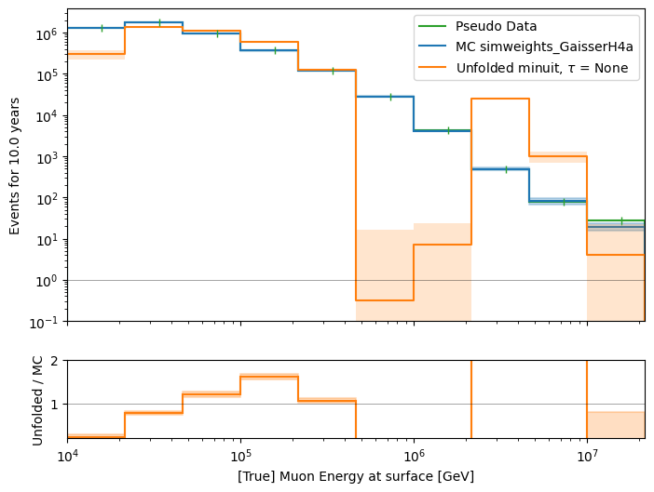
fit all, use 4 fitted systematic bins as x0
x0 = [1e5, …, 1.0165, 1.0069, 1.0302, 0.193], bounds = yes

Slide 11
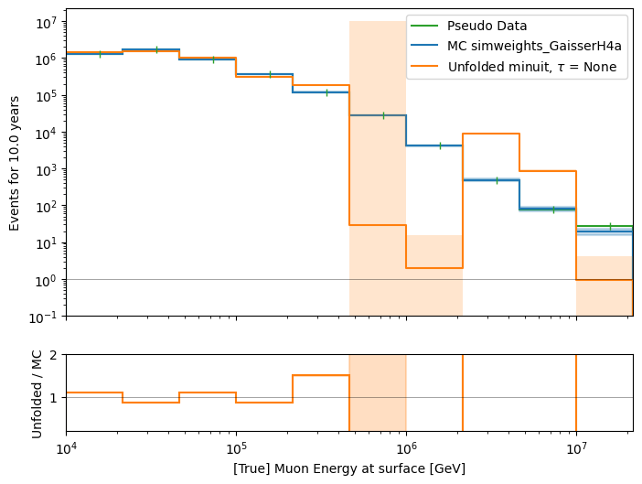
fix 4 systematic bins, fit unfolding bins
x0 = [1e5, …, 1.0165, 1.0069, 1.0302, 0.193], bounds = yes

Slide 12
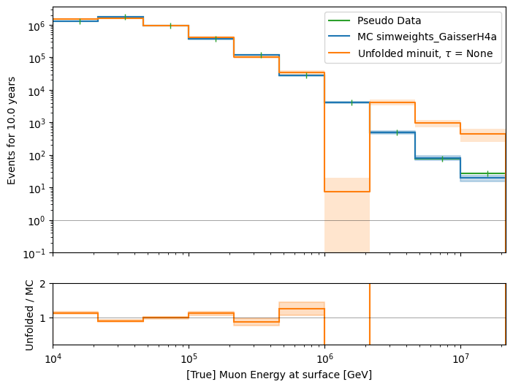
fix 4 systematic bins, fit unfolding bins
x0 = [True values * 1.1, 1.0165, 1.0069, 1.0302, 0.193], bounds = yes

Slide 13
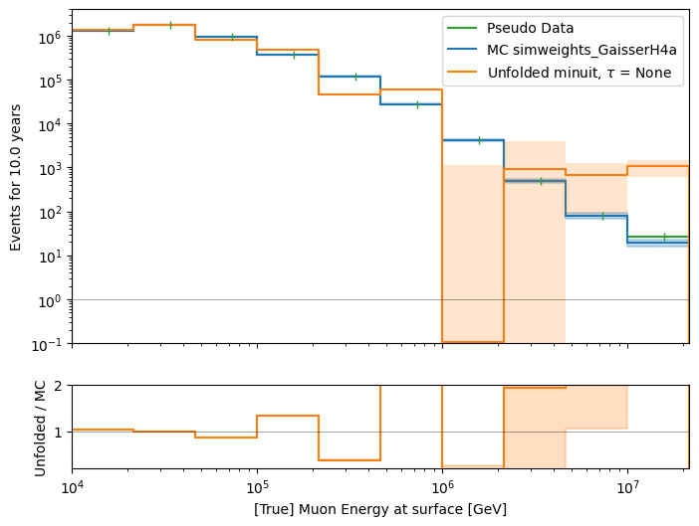
fix 4 systematic bins, fit unfolding bins
x0 = [True values * 0.5, 1.0165, 1.0069, 1.0302, 0.193], bounds = yes

Slide 14
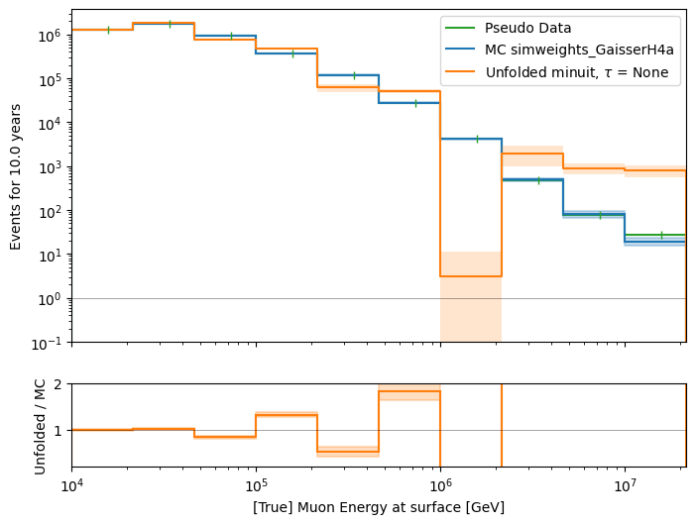
fix 4 systematic bins, fit unfolding bins
x0 = [True values , 1.0165, 1.0069, 1.0302, 0.193], bounds = yes

Slide 15
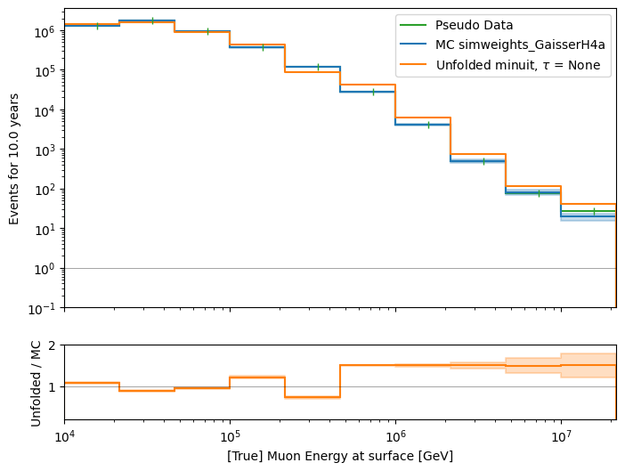
fit all, bounds +/- 50%, and fitted systematics
at 50% limit

Slide 16
Adjust fitting of systematic bins
Use Gaussian error (baseline and subset)
Use chi2 tests

Slide 17
Fit systematic bins: use chi2 tests
y = 1
(chi2 test)
Fit constant c
(chi2 test)
Fit linear
mx + n
(chi2 test)
Set f(x) = c
Set f(x) = 1
Set f(x) = mx + n
Intersection of f(x) and baseline uncertainties
f(x) above/below baseline
Set f(x) to upper limit of baseline uncertainty
Set f(x) to lower limit of baseline uncertainty
done

